Slide 1

01
EMERGENCY PANIC BUTTON SYSTEM
PARVATHY KRISHNA A
CB.SC.U4CSE23739

Slide 2
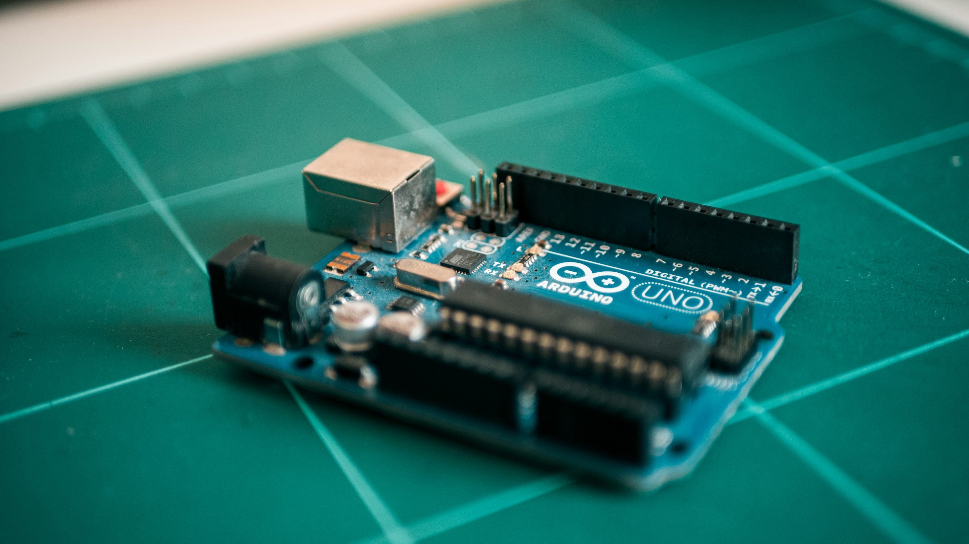
Introduction
The project involves creating a simple interactive system using an Arduino microcontroller, designed to respond to user input through a push button. By integrating a button, an LED, and a buzzer, the setup provides immediate visual and auditory feedback when the button is pressed. This foundational project showcases the principles of digital input and output, emphasizing the importance of user interaction in electronics.

Slide 3

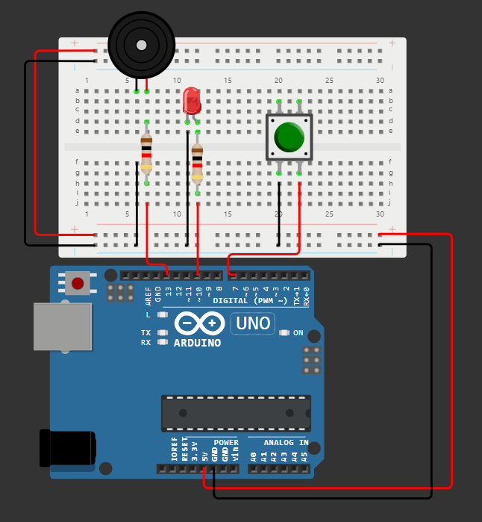
CIRCUIT DESIGN
LED
Push Button
Buzzer
Resistor
Arduino Uno
https://wokwi.com/projects/412815710589040641

Slide 4
CONNECTIONS
Button: Connect one terminal to the specified pin (e.g., pin 7) and the other to ground. If using a pull-up resistor, connect the pin to Vcc (5V) through a resistor and the button to ground.
LED: Connect the anode (longer leg) to the specified pin (e.g., pin 10) and the cathode (shorter leg) to ground. A resistor (typically 220Ω) is used in series to limit current.
Buzzer: Connect one terminal to the specified pin (e.g., pin 13) and the other terminal to ground.

Slide 5
ALGORITHM
1. Define Structure: Create a GPIO_Pin structure for pin number and mode.
2. Initialize Pin: Implement initPin to set the pin mode.
3. Define Pins: Create GPIO_Pin instances for a button, LED, and buzzer.
4. Initialize Pins: Use initAllPins to initialize all GPIO pins.
5. Activate Functions:
5.1 Define:
5.1.1 activateLEDAndBuzzer: Turns on LED and plays buzzer tone.
5.1.2 deactivateLEDAndBuzzer: Turns off LED and stops tone.
5.2 Setup:
5.2.1 Initialize pins.
5.2.2 Start with LED and buzzer off.
5.3 Loop:
5.3.1 Check button state.
5.3.2 Activate/deactivate LED and buzzer based on button press.
5.3.3 Include a 10 ms delay for stability.

Slide 6
CODE
#include <Arduino.h>
// Define a structure for a GPIO pin
typedef struct {
uint8_t pinNumber; // Pin number
uint8_t mode; // Pin mode (INPUT/OUTPUT)
} GPIO_Pin;
// Initialize a GPIO pin by setting its mode
void initPin(GPIO_Pin *gpio) {
pinMode(gpio->pinNumber, gpio->mode); // Set the mode of the pin
}
GPIO_Pin button = {7, INPUT}; // Button on pin 7
GPIO_Pin led = {10, OUTPUT}; // LED on pin 10
GPIO_Pin buzzer = {13, OUTPUT}; // Buzzer on pin 13

Slide 7
// Function to initialize all GPIO pins
void initAllPins(GPIO_Pin *pins[], int count) {
for (int i = 0; i < count; i++) {
initPin(pins[i]); // Initialize each pin
}
}
// Function to turn on the LED and play the buzzer tone
void activateLEDAndBuzzer() {
digitalWrite(led.pinNumber, HIGH); // Turn on the LED
tone(buzzer.pinNumber, 1000); // Play a 1000 Hz tone
}
// Function to turn off the LED and stop the buzzer tone
void deactivateLEDAndBuzzer() {
digitalWrite(led.pinNumber, LOW); // Turn off the LED
noTone(buzzer.pinNumber); // Stop the tone
}

Slide 8
void setup() {
// Create an array of pin pointers
GPIO_Pin *pins[] = {&button, &led, &buzzer};
// Initialize all GPIO pins
initAllPins(pins, 3);
// Start with LED and buzzer off
deactivateLEDAndBuzzer();
}
void loop() {
// Check if the button is pressed
if (digitalRead(button.pinNumber) == HIGH) {
activateLEDAndBuzzer(); // Activate LED and buzzer
} else {
deactivateLEDAndBuzzer(); // Deactivate LED and buzzer
}
delay(10); // Small delay for stability
}

Slide 9
Applications
User Interfaces: Simple systems for user input using button controls.
Indicators: Visual (LED) and audio (buzzer) indicators for alarms or notifications.
Learning and Prototyping: Ideal for educational purposes and prototyping basic electronic circuits.
Games and Toys: Interactive games where buttons trigger sound and light effects

Slide 10
THANK YOU!

